Slide 1


Used Car Prices: A Regression ML Model Optimized with OPTUNA
This presentation explores a machine learning model built to predict used car prices. We use a regression model optimized using OPTUNA, a hyperparameter optimization library. This model can provide valuable insights for buyers and sellers in the used car market.
by Karthikeyan V

Slide 2
Overview of the Used Car Pricing Dataset
Features
Target Variable
Data Preprocessing
Make
The target variable in this dataset is the price of the used car. This is the value we aim to predict using the model.
Before building the model, data preprocessing is crucial. This involves handling missing values, converting categorical features, and scaling numerical features.
Model
Year
Mileage
Engine Size
Transmission
Body Style

Slide 3

Building the Regression Model
1
2
3
Model Selection
Model Training
Model Evaluation
We explored various regression models, including linear regression, decision trees, and random forests, to find the best fit for our dataset.
The selected model was trained on the preprocessed data, allowing it to learn patterns and relationships between features and car prices.
We evaluated the trained model's performance using metrics like R-squared and mean squared error to assess its accuracy and predictive power.

Slide 4
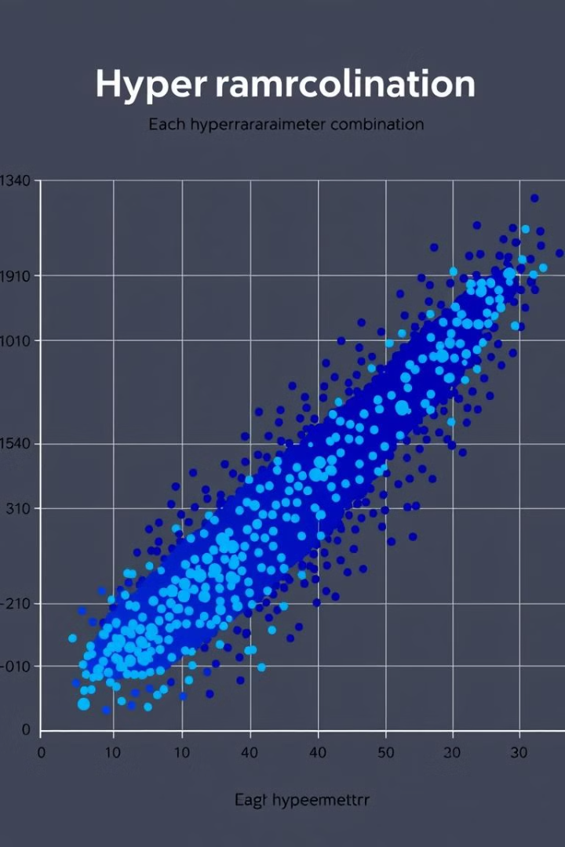
Hyperparameter Optimization with OPTUNA
Hyperparameters
OPTUNA's Role
Hyperparameters control the learning process of a machine learning model. They are not learned from data but need to be manually tuned for optimal performance.
OPTUNA is a library that automates hyperparameter optimization. It efficiently explores different combinations of hyperparameters to find the best settings for our model.
Performance Improvement
By using OPTUNA, we significantly improved the model's performance, achieving more accurate predictions and better generalization on unseen data.

Slide 5




Deploying the Model using Gradio
Gradio Interface
Gradio is a library that simplifies the process of deploying machine learning models as user-friendly web applications.
Interactive Prediction
Our model, deployed using Gradio, allows users to input used car features and instantly receive a price prediction from the trained model.
Accessibility
The Gradio interface makes our model accessible to a broader audience, enabling anyone to use it for their used car price estimations.

Slide 6

Key Takeaways and Next Steps
1
Model Accuracy
2
Hyperparameter Optimization
The optimized regression model consistently predicts used car prices with high accuracy, providing valuable insights for buyers and sellers.
OPTUNA proves to be an effective tool for hyperparameter tuning, significantly improving model performance and achieving optimal results.
3
User-Friendly Deployment
Gradio provides a user-friendly interface for deploying our model, making it accessible to a wider audience and facilitating real-world applications.

